Slide 1
Building chatbots with MS Bot Framework
Saving to Database

Slide 2
Copy files from here
https://github.com/code-monster-kevin/chatbot-102/tree/save-to-db

Slide 3
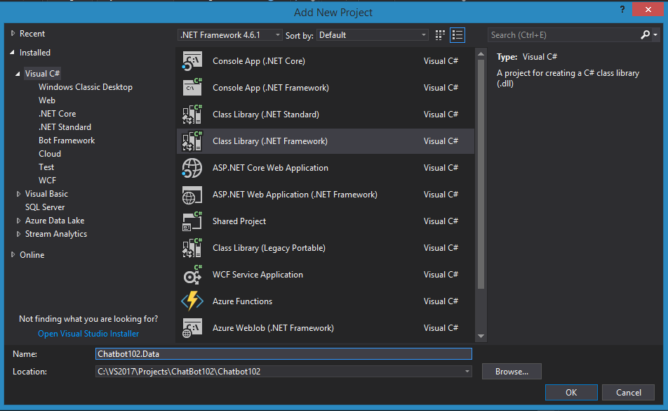
Create a new Class Library Project

Slide 4
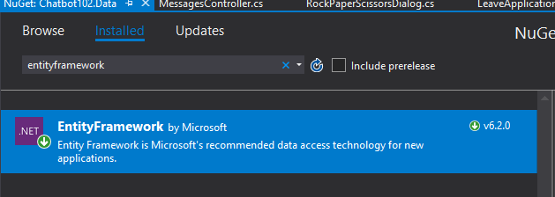
Install EntityFramework Nuget Package to both Chatbot102.Data project and Chatbot project

Slide 5
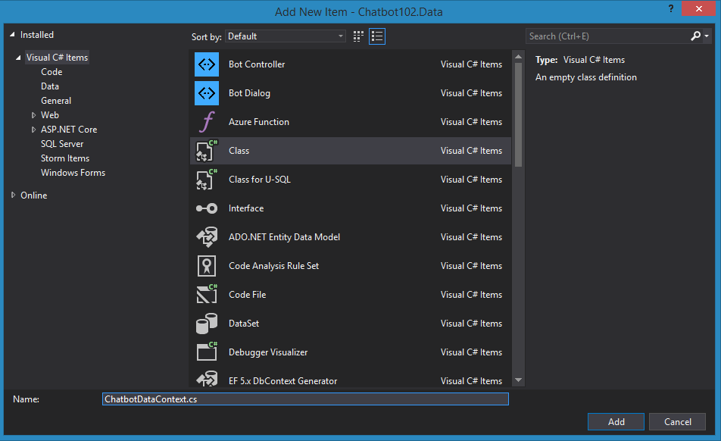
Add a new “ChatbotDataContext.cs” class

Slide 6
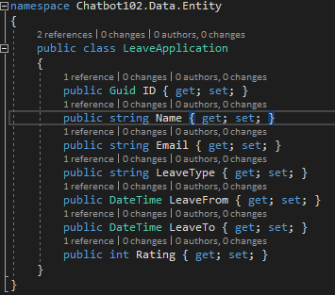
Add a new “Entity” Folder and “LeaveApplication.cs” class

Slide 7
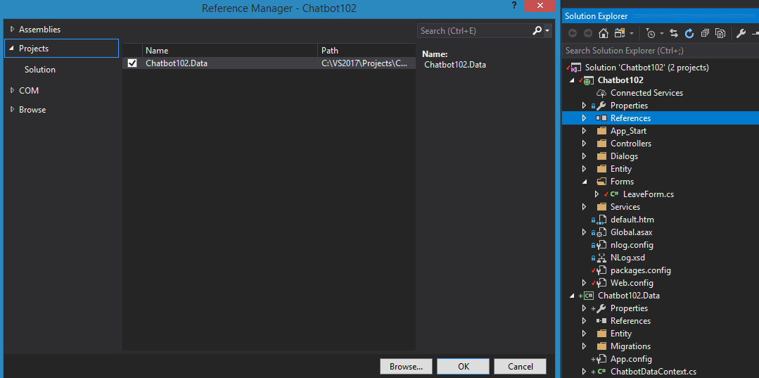
Chatbot102 - Add Reference to Chatbot102.Data project

Slide 8
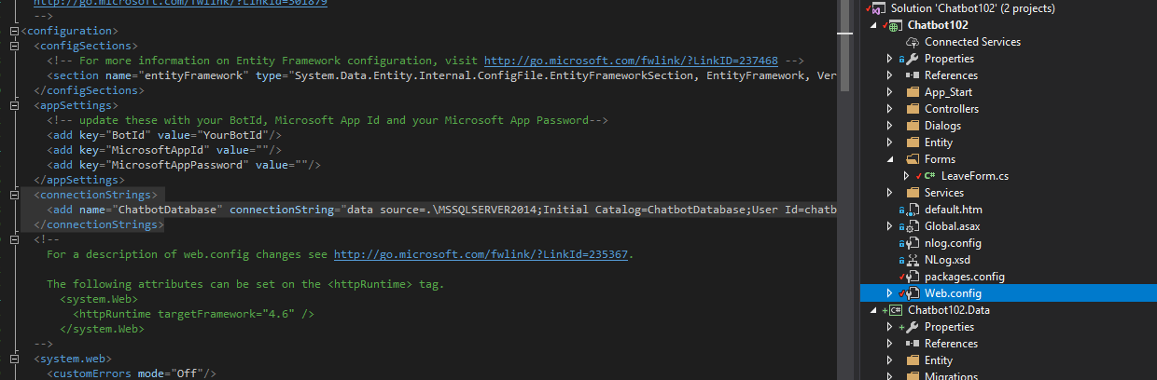
Chatbot102 Web.config add “ConnectionString”

Slide 9
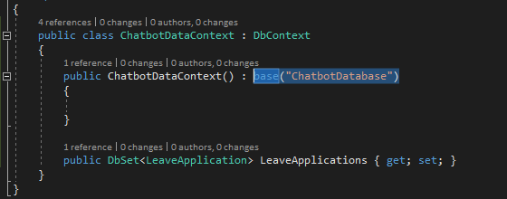
Fill in the connection string to YOUR database
<add name="ChatbotDatabase" connectionString="data source=.;Initial Catalog=ChatbotDatabase;User Id=chatbot;password=123;Integrated Security=False;" providerName="System.Data.SqlClient"

Slide 10
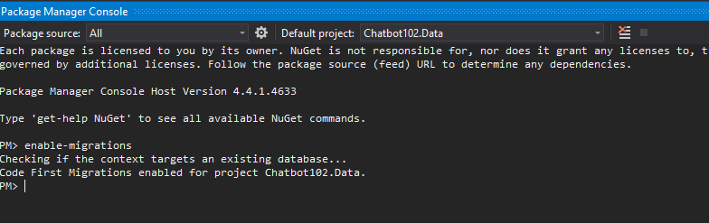
Enable Migrations

Slide 11
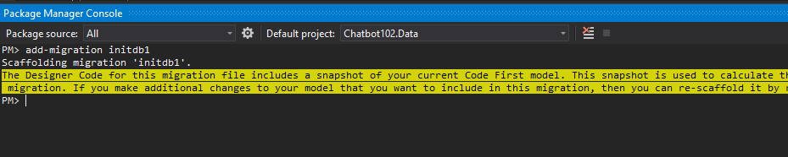
Add-migration

Slide 12
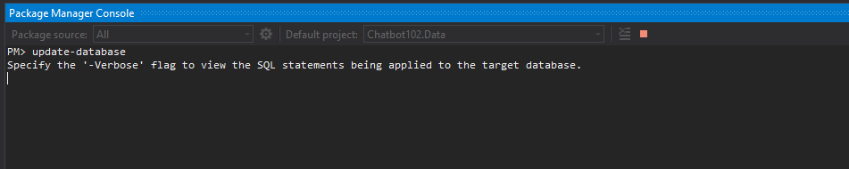
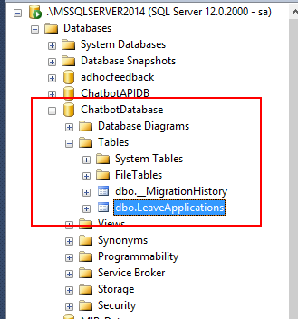
Update-database

Slide 13
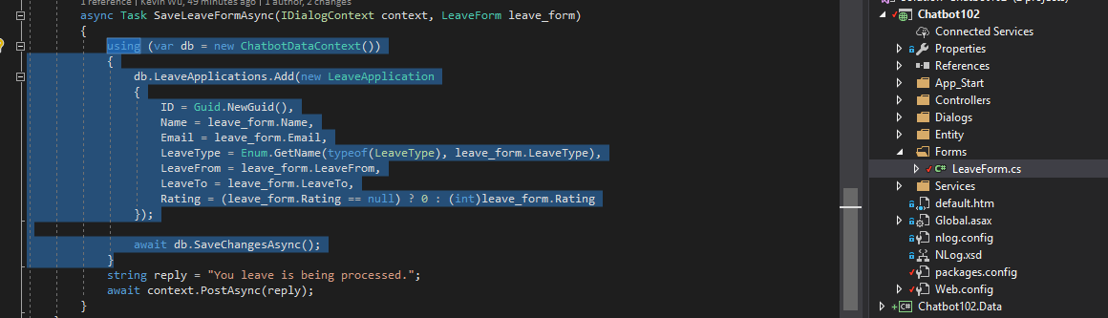
Save the LeaveForm data to database

Slide 14
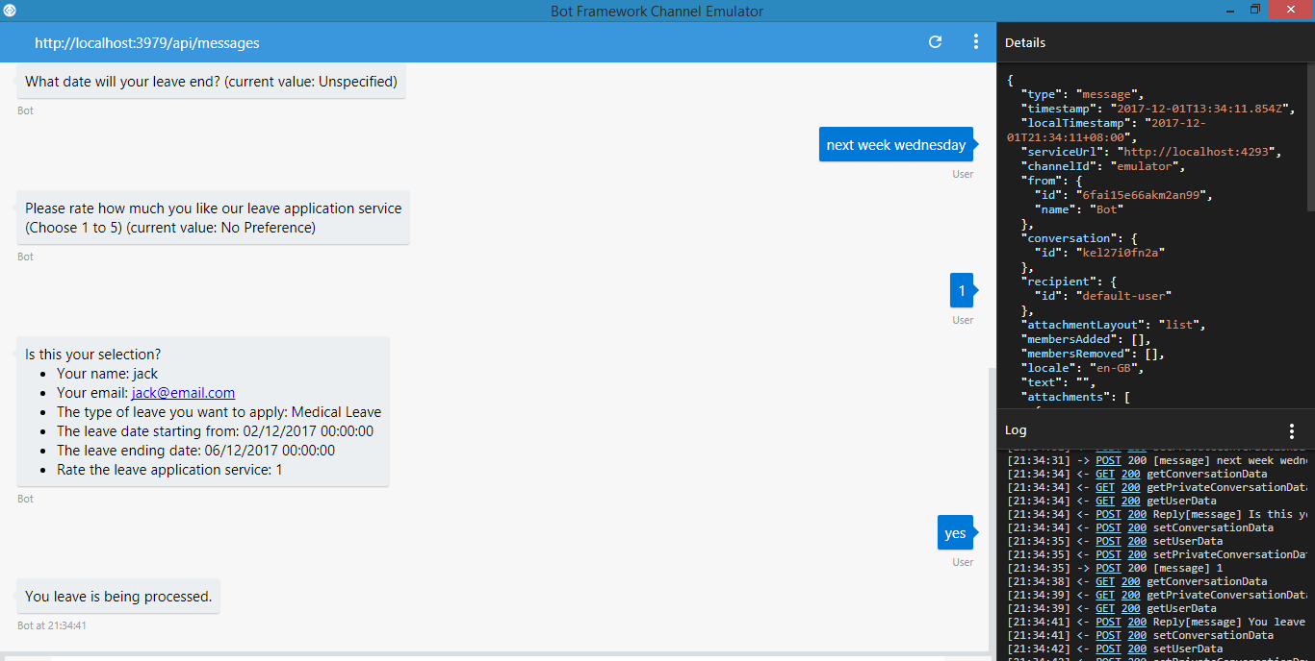
Run the application

Slide 15
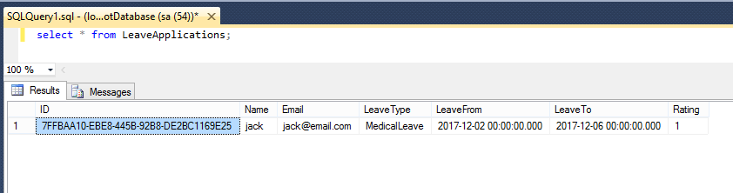
Data is now in the database

